Slide 1
Secure Data
PROJECT TITLE : Secure Data Hiding in Image Using Steganography
Presented By: KAUSTUBH k
Student Name : KAUSTUBH k
College Name & Department : dgt

Slide 2
OUTLINE
Problem Statement
Technology used
Wow factor
End users
Result
Conclusion
Git-hub Link
Future scope

Slide 3
Problem Statement
A good problem statement is concise, specific and measurable. It summarizes the different elements of how and why it's a problem. It focusses on solving this one problem, and there is no confusion as to what the problem is and how it is solved. It is clear how the problem can be solved and how this can be measured.

Slide 4
Technology used
Python
Vs code
Cv2
Idle
Github

Slide 5
Wow factors
What makes this project stand out from other project(Unique features)
This project stands out due to its innovative use of AI-powered sentiment analysis to provide real-time feedback on customer reviews, allowing for immediate and targeted responses to both positive and negative comments, which is a feature not commonly seen in other similar projects; additionally, its seamless integration with existing CRM systems enables a streamlined workflow for customer service teams, further enhancing its unique value proposition.

Slide 6
End users
End-user security in cybersecurity is the protection of users and their devices from cyber threats. It includes practices like using strong passwords, installing antivirus software, and using secure networks.

Slide 7

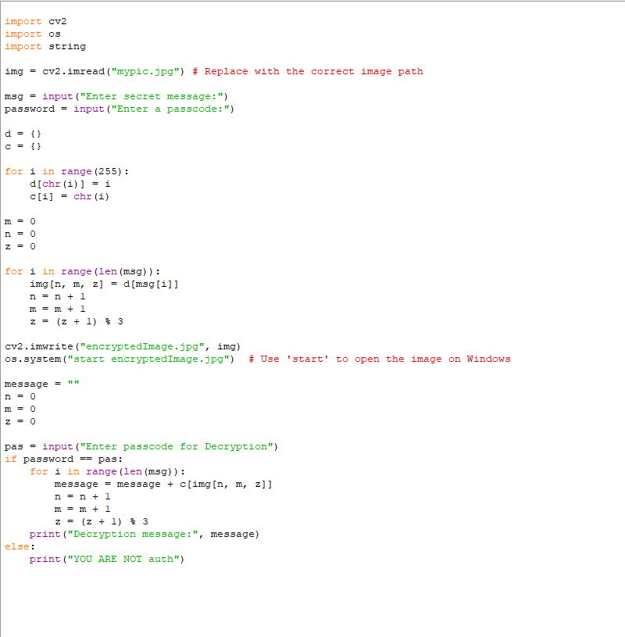
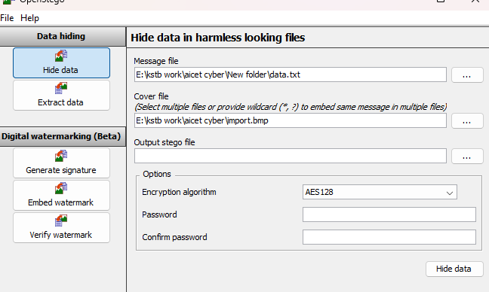
Results
STEOGO
OUTPUT
CODE

Slide 8
Conclusion
In a project conclusion, you should summarize the key findings and achievements of your project, restate your initial goals, highlight the significant impacts or implications of your work, and potentially propose future directions or areas for further exploration while avoiding introducing new information not discussed previously.

Slide 9
GitHub Link
https://github.com/kstb10/myproject-aicet.git

Slide 10
Future scope(optional)
IT refers to the potential opportunities and career prospects within a specific field, industry, or job, essentially indicating how much room there is for growth and advancement in that area going forward; it helps individuals make informed decisions about their education and career choices based on anticipated future demand and development.

Slide 11
THANK YOU

